Slide 1









MOBILE APPLICATION FOR THE ARCHIVAL AND RETRIEVAL MISSING OBJECT
24
REQUIREMENT GATHERING

Slide 2
OUTLINE
Introduction
01
Stakeholders
02
Requirement Gathering Process
03
Conclusion
04

Slide 3

Introduction
Traditional methods of recovering lost items are frustrating and unreliable.
This project proposes a mobile app leveraging image matching to reunite lost objects with their owners.
By harnessing digital technology, we aim to significantly improve retrieval success rates.

Slide 4

Identifying stakeholders
Internal Stakeholders
External Stakeholders

Slide 5
Requirement Gathering Techniques
Interviews
01
Survey form
02
03
Brainstorming
04
Research

Slide 6

Interviews
User Needs
Document Management Features
Other Features
Conclusion

Slide 7
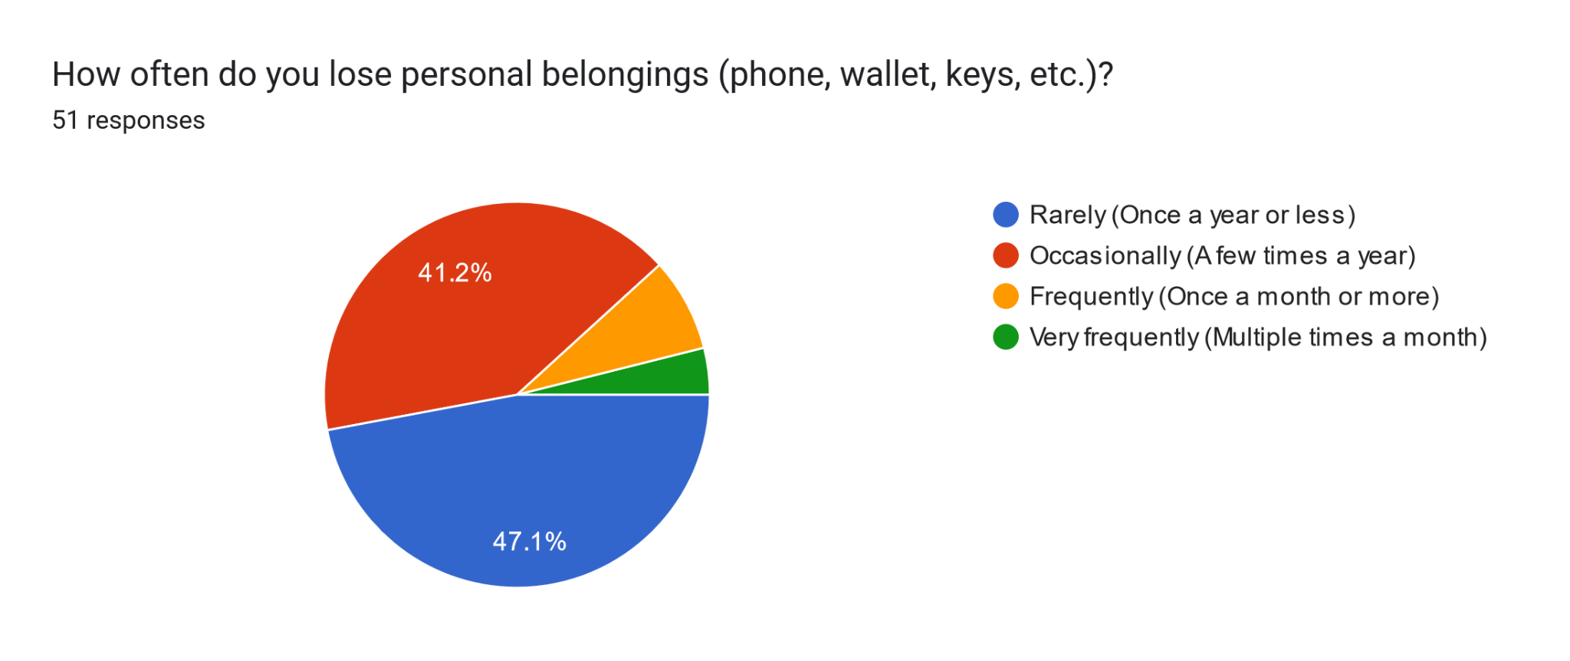
Surveys

Slide 8
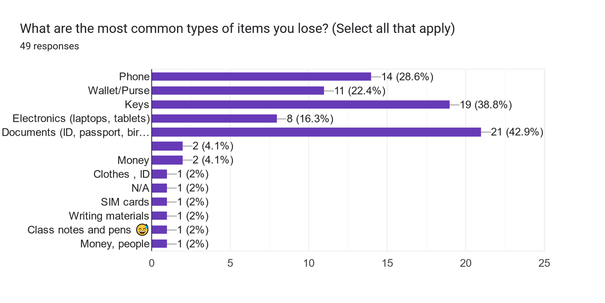
Surveys

Slide 9
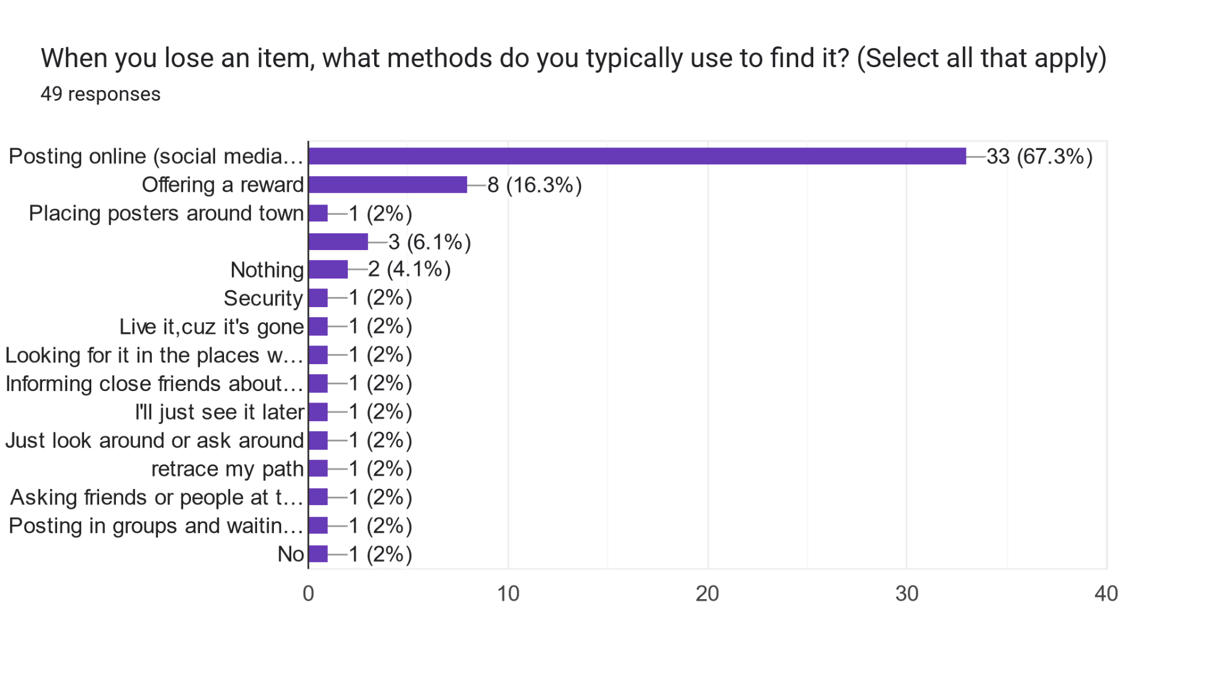

Slide 10
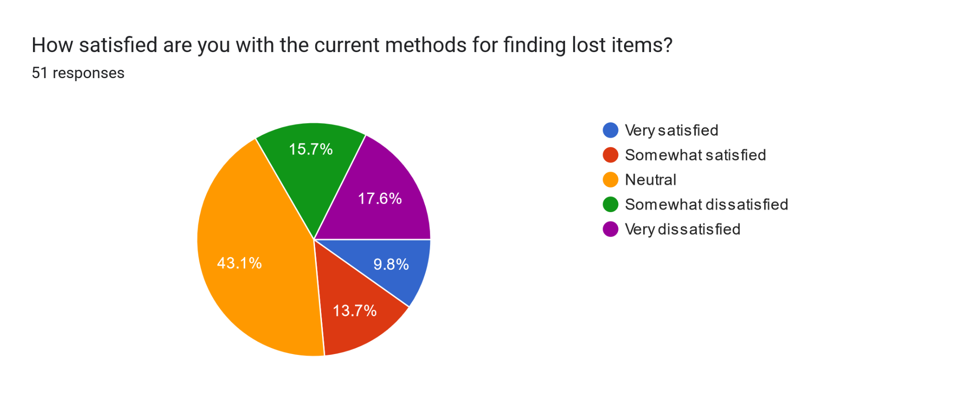
Surveys

Slide 11
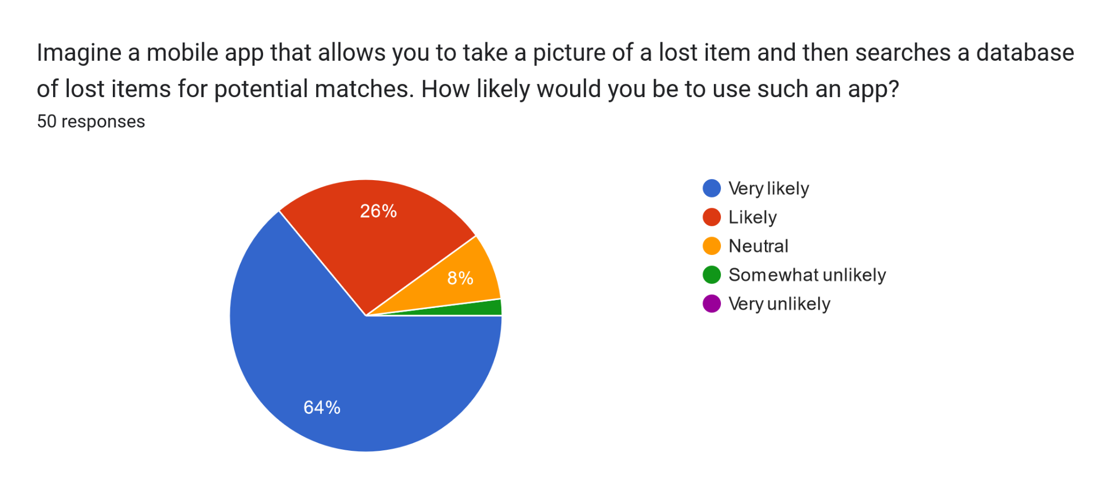
Surveys

Slide 12
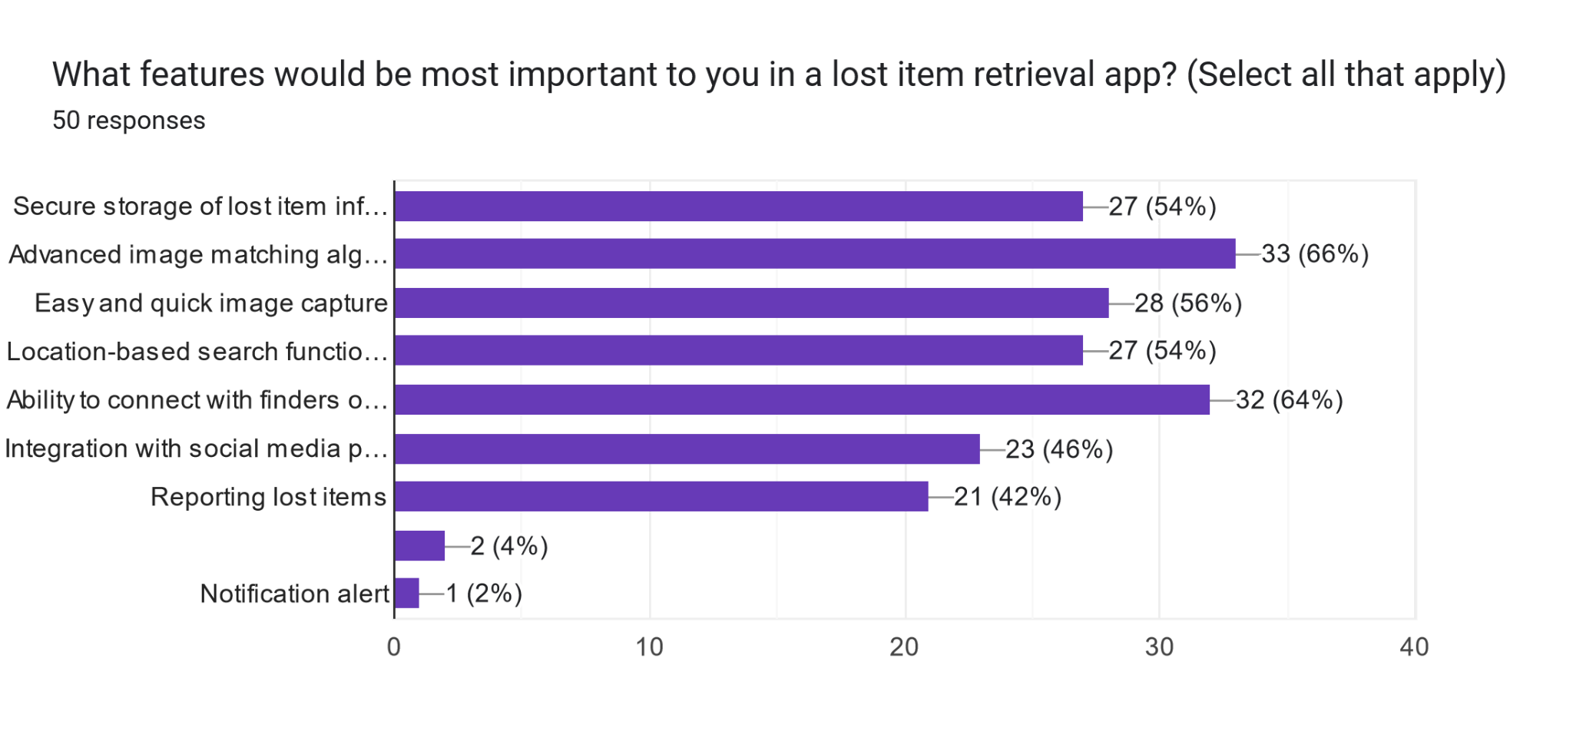
Surveys

Slide 13

Brainstorming
Focus on Development Considerations
Key Finding
- Inter-App Communication and Sharing
-User Communication
-User Notifications and Tracking:
-User Customization
-Location Tracking
-Content Recognition
-Performance Optimization

Slide 14
Desired Functionalities
01
Research
Deep learning
02
Existing Apps
03
User Pain Points
04

Slide 15
Conclusion
Thanks for your Keen Attention!!

